Slide 1

Advancing Organic Photovoltaics with Infrastructure for Transferable, Reproducible, Useable, and Extensible (TRUE) Multiscale Models
September 22, 2020
Jenny W. Fothergill

Slide 2
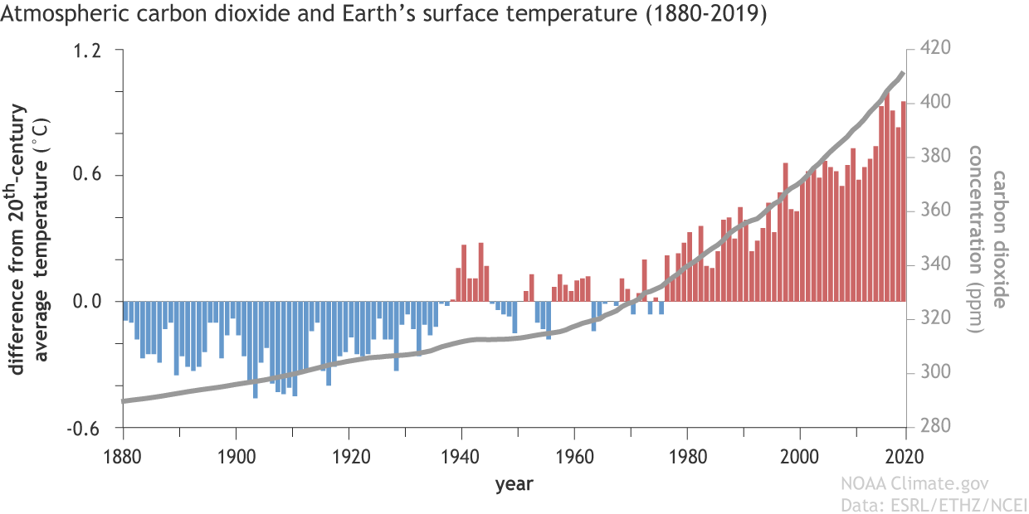
Climate and Atmospheric CO₂
Notes:
https://www.climate.gov/news-features/climate-qa/if-carbon-dioxide-hits-new-high-every-year-why-isn%E2%80%99t-every-year-hotter-last

Slide 3
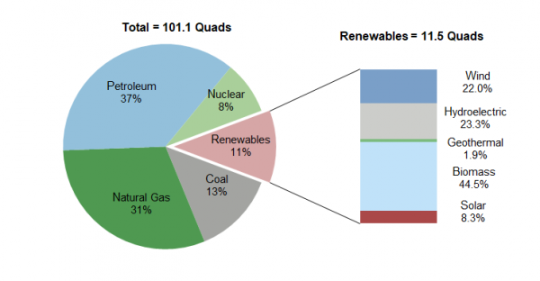
US Energy Portfolio
Notes:
http://css.umich.edu/factsheets/us-renewable-energy-factsheet

Slide 4
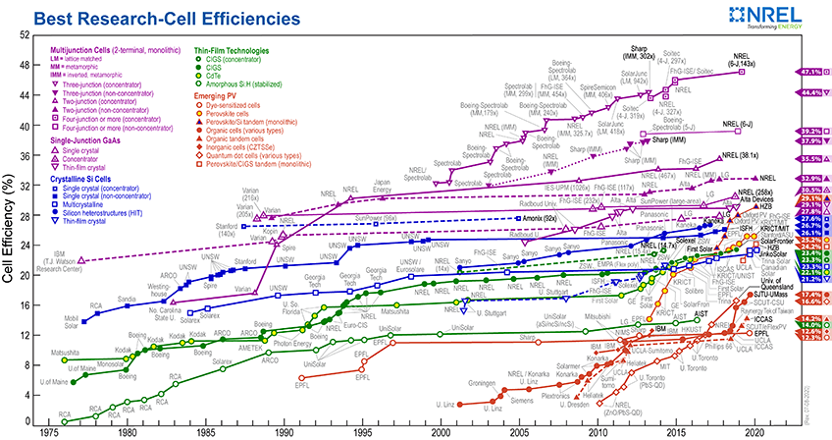
Solar Power

Slide 5
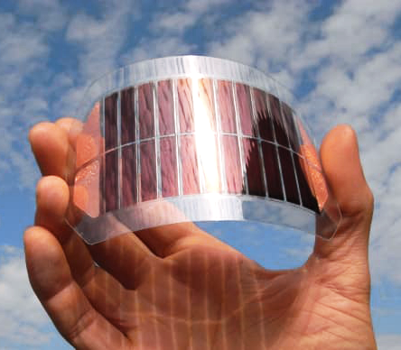
OPVs
Notes:
https://solenergy.com.ph/the-rise-of-organic-photovoltaics/
Dou2013

Slide 6
History

Slide 7
How OPVs Work

Slide 8
Zoo

Slide 9
Plan?

Slide 10
Molecular Dynamics

Slide 11
Coarse Graining

Slide 12
These achieve the same result
hexane_sites = [("_A", "C[CH3]"), ("_B", "CC")]

Slide 13
Objectives

Slide 14
Timeline

